Slide 1
Introduction to Data Engineering
– Data Processing
Dávid Szabó

Slide 2
Data Processing: From Input to Useful Output
Data processing applies repeatable rules to turn accepted input into a more useful output.
It may run immediately after ingestion or later through several refinement steps.
Typical outputs include validated records, structured fields, enriched datasets, aggregates, and model-ready data.
The key questions are:
• What input contract is accepted?
• What output contract is promised?
• Can the result be reproduced?
raw sensor events → validated readings → enriched measurements → daily metrics
Notes:
Teaching emphasis:
Define processing by repeatable rules and an explicit input/output contract, not by one mandatory physical middle layer.
Walk through the sensor flow. Each arrow creates a different representation or guarantee for a downstream use.

Slide 3
Ingestion vs Processing — The Boundary Is the Responsibility
Some operations can belong to either side. Classify them by the responsibility they serve—not by the tool that runs them.
Safe landing / ingestion
Read and preserve the payload safely
Handle transport-level validation
Remove transport duplicates only when the source contract defines them
Reusable data / processing
Create a documented, reusable schema
Apply business deduplication and standardization
Enrich, aggregate, or otherwise change meaning and usability
↔
Processing begins when repeatable rules create a new representation, meaning, or guarantee.
Notes:
Use responsibility—not technology—to explain the gray zone.
Technical parsing needed to land data safely may belong to ingestion. Typing and projecting reusable fields, or applying business rules, is processing.
The same tool or job may perform both responsibilities. The contract is the useful boundary.

Slide 4
Processing Responsibilities — Not a Fixed Sequence
Pre-processing and information extraction are possible parts of processing—not two mandatory stages. Their order depends on the input.
1 Structure / extract
Select and type fields when the input does not yet provide a usable structure
2 Validate / clean
Deduplicate, check required values, and quarantine invalid records
3 Transform / enrich
Standardize values and join metadata
4 Aggregate / model
Calculate new representation metrics and/or produce model-ready data
→
→
→
Sensor example: raw event → typed fields → validated readings → enriched records → daily metrics
Steps may be skipped, combined, reordered, or performed partly during ingestion.
Notes:
Do not present the four boxes as a mandatory pipeline.
Information extraction is needed when the input lacks usable structure. Pre-processing is defensive validation and cleaning before purpose-specific logic.
Either responsibility may be skipped, combined, or reordered. For structured sensor JSON, extraction may mean only selecting and typing fields.

Slide 5
ETL and ELT: Where Does Transformation Run?
Both patterns extract data, transform it, and make it available in a target system.
ETL — transform before loading into the analytical target
ELT — load raw or lightly prepared data first, then transform using target-side compute
Useful historical rule of thumb:
  ETL is associated with traditional integration platforms and constrained warehouses
  ELT became prominent with scalable cloud warehouses and lakehouses
This is a tendency, not the definition: modern systems often combine both patterns.
Example:
  sensor readings may be validated in Spark before loading, or loaded first and transformed with SQL.
ETL may span both ingestion and processing:
  Extract may read directly from a source, or it may read data already landed by a separate ingestion process.
  Ingestion and processing describe responsibilities; ETL and ELT describe the order and placement of operations.

Slide 6
ETL: Transform Before Loading
Flow: Extract → Transform → Load
Typical fit:
  the target should receive only controlled, ready-to-use data
  the target is not the preferred place to run heavy transformation
  sensitive fields must be removed or masked before reaching that target
Sensor example:
  Read a raw daily file → parse timestamps → quarantine invalid rows → calculate daily averages → load the summary table
Strength: tight control over what enters the target.
Trade-off: replay requires retained inputs and the external transformation environment.

Slide 7
ELT: Load Before Transforming
Stage | General role | Sensor example
Extract | Read from the source or landing area | Read raw sensor events
Load | Persist in the analytical platform | Load a Bronze/raw table
Transform | Use target-side compute | SQL validates types and timestamps
Publish | Materialize trusted outputs | Create Silver readings and Gold metrics
Typical fit | Capable warehouse or lakehouse | Databricks, Synapse, or similar
So does ELT cover Ingestion?
  When Extract reads an external source and Load creates its first durable copy in the platform, these steps together implement ingestion.
  If the input was already landed, the ELT workflow starts after ingestion.
Strength: raw data becomes available quickly and can support new transformations without re-extraction.
Trade-off: the landing area needs strong access control, cost management, and governance.
Loading raw data first still requires controlled access, documented schemas, and tested transformations.

Slide 8
One Dataset, Two Valid Designs
Goal: produce validated daily temperature metrics from the same raw sensor events.
ETL design:
  Python or Spark validates, deduplicates, and aggregates before loading the analytical table
ELT design:
  Raw events are loaded into a governed lakehouse; SQL or dbt models create the same validated outputs
What remains the same:
  input contract, quality rules, output contract, lineage, and safe reruns
What changes:
  where compute runs, when raw data becomes available, and which platform bears the cost
A single platform may use ETL for sensitive sources and ELT for other datasets.
Rule of thumb: ETL is historically associated with traditional integration; ELT grew with cloud analytics.

Slide 9
Choosing ETL or ELT — A Practical Heuristic
ETL tends to fit when the target should receive controlled outputs;
ELT tends to fit when the target can govern raw data and execute transformations efficiently.
Many systems combine both:
  some transformations run before loading, while others run inside the target platform.
Question | ETL tends to fit | ELT tends to fit
Transformation compute | External engine | Target warehouse/lakehouse
Raw data in target | Restricted or unnecessary | Useful and governed
Sensitive fields | Remove before target | Controlled raw zone is acceptable
Fast landing and reuse | Less central | Important advantage
Which skills team has? | Python, Spark, integration tools | SQL, dbt, target-native compute

Slide 10
Bounded and Unbounded Data
Bounded input has a known end.
  Example: one daily CSV containing all readings received on 2026-09-10
  A batch job can finish after every record in that input has been considered
Unbounded input keeps arriving.
  Example: a Kafka topic receiving live sensor events
  Processing updates results incrementally because there is no final record
The business goal may be identical: average temperature per sensor.
The unbounded version additionally needs state, time windows, late-data rules, and continuous recovery.
Useful default:
  bounded data → batch processing;
  unbounded data → stream processing.
Notes:
Transition from ETL/ELT:
Whether sensor events arrived through files and APIs or through Kafka, the next processing question is whether the input is bounded or continuously arriving.
The ingestion mechanism does not by itself determine the processing model.

Slide 11
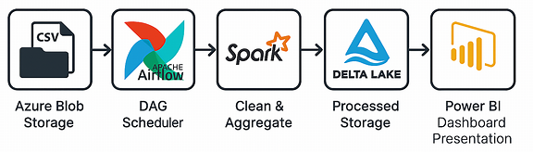
Batch Processing Architecture — Separate the Roles
Input/storage
  holds a bounded dataset such as one daily sensor partition
Orchestrator
  schedules run and manages task dependencies and retries
Processing engine
  parses, joins, validates, and aggregates the records
Output storage
  persists trusted, reproducible results
Consumers
  query the results through BI, APIs, notebooks…
Monitoring spans every role:
  status, duration, volume, quality, and freshness.
Example shown:
Azure Blob Storage → Airflow → Spark → Delta Lake → Power BI
Airflow coordinates the work;
Spark performs the distributed transformation.
Products can change while responsibilities remain.
Notes:
Read the architecture from left to right, but separate responsibilities from products.
Airflow coordinates when work runs and what depends on what. Spark is the component that executes distributed transformations. Delta Lake stores the resulting tables; Power BI consumes them.
This distinction prepares the Lab 05 DAG: the lab uses Airflow as orchestrator and Python/pandas as the processing implementation.

Slide 12
Stream Processing — Unbounded Input, Incremental Results
Stream processing consumes an unbounded input as new events arrive.
Because the input has no final record, results updated incrementally rather than produced once at the end.
Streaming describes the processing model; real-time describes the required latency.
Sensor example:
  validate each new reading
  update a five-minute average for its sensor
  emit an alert when an explicit rule is violated
The processor must handle duplicates, ordering, late events, failures, and changing input rates.
Useful default: use streaming when the result must evolve while data continues to arrive.

Slide 13
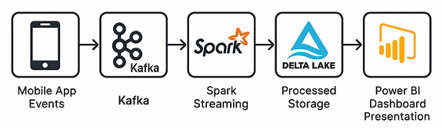
Stream Processing Architecture — Separate the Roles
Event source
  produces an unbounded sequence of events
Transport/buffer
  retains and distributes events
Stream processor
  validates, enriches, aggregates, and detects patterns
Processing state
  remembers progress and intermediate results
Sink
  stores results or triggers downstream actions
Consumers
  dashboards, APIs, alerts, and other pipelines
Example shown:
Mobile events → Kafka → Spark Structured Streaming → Delta Lake → Power BI
Kafka transports and retains events;
Spark performs the transformation.
Checkpointed state helps the processor resume after failure; it is not a replacement for output storage.
Notes:
Read the diagram by responsibility rather than by logo.
Kafka is the event transport and retained log. Spark Structured Streaming executes transformations. Delta Lake stores processed results. Power BI consumes those results.
Emphasize that a stream processor usually has internal state and recovery metadata in addition to its visible output.

Slide 14
From Streaming Mechanics to an Operable Pipeline
The following slides answer four groups of design questions.
1 Correctness over time
What must the processor remember?
State • event time • windows • watermarks • late data
2 Current and historical results
How can results be produced or rebuilt?
Lambda • Kappa • replay • reprocessing
3 Explicit and operable processing
How is work defined and run?
Principles • contracts • engines • orchestrators • DAGs
4 Reliability under failure
What happens when data or systems fail?
Quality • scalability • SLOs • retries • quarantine • idempotency • observability
These are design questions—not additional mandatory pipeline stages.
Notes:
Teaching emphasis:
This slide is a map of the next section, not another physical pipeline.
The four groups cover streaming semantics; live versus historical computation and rebuilding; explicit execution and orchestration; and reliability under data or system failure.

Slide 15
SECTION 1 OF 4
1
Correctness Over Time
State, event time, windows, watermarks, and late data
A new design question—not another mandatory pipeline stage.

Slide 16
Stateless and Stateful Processing
Stateless processing needs only the current record.
  Examples: parse JSON, convert °F to °C, validate one value against a fixed range
Stateful processing remembers information across records.
  Deduplication — have we already seen this event_id?
  Aggregation — what is the five-minute average for sensor S1?
  Join — which location was assigned to this sensor at event time?
  Pattern detection — did three abnormal readings occur within ten minutes?
State is commonly partitioned by a key such as sensor_id and periodically checkpointed for recovery.
State must also have a lifetime: without expiry or window boundaries, it can grow without limit.

Slide 17
Event Time, Windows, Watermarks, and Late Data
Event time — when the measurement happened, stored in the event
Processing time — when the processing system handled the event
A window turns an unbounded stream into finite groups, for example 10:00-10:05.
Watermark(T) — the processor currently considers event time to have advanced past T.
  An event arriving later with event_time ≤ T is treated as late
  Common policy: watermark = largest observed event time − allowed delay
Example: largest observed event time=10:10 and allowed delay=5 minutes → watermark=10:05.
  The 10:00-10:05 window can be evaluated; a later arrival with event_time=10:02 is late
  The lateness policy decides whether to update the result, route the event elsewhere, or ignore it.
  A watermark is about time and completeness; a checkpoint is about recovery.
  Trade-off: a slower watermark waits for more data but delays the result.
Notes:
Use one concrete policy: maximum observed event time minus five minutes of allowed delay.
If the maximum observed event time is 10:10, the watermark is 10:05. A later arrival with event_time=10:02 is classified as late.
A timestamp is a value on a record. A watermark is derived event-time progress. A checkpoint persists processing state for recovery.
Transition: State and time explain how live results evolve. Next ask how low-latency results can coexist with historical correction or rebuilding.

Slide 18
SECTION 2 OF 4
2
Current and Historical Results
Lambda, Kappa, replay, and reprocessing
A new design question—not another mandatory pipeline stage.

Slide 19
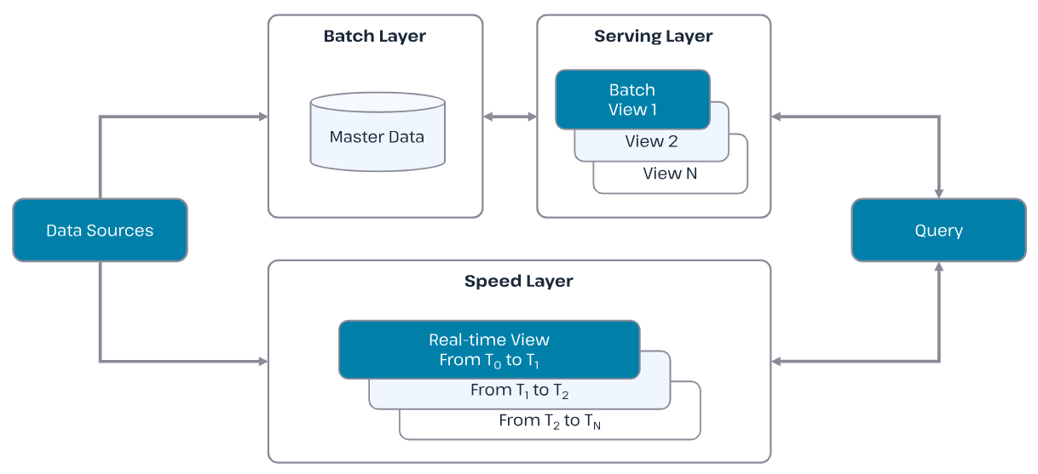
Lambda Architecture — Batch and Speed Paths
Lambda processes the same incoming data through two processing paths—not necessarily two ingestion mechanisms:
  Batch layer — recomputes complete historical views
  Speed layer — produces low-latency, provisional results for recent data
  Serving/query layer — exposes a result that combines complete history with recent updates
Benefit: responsive results that can later be corrected by the batch path.
Cost: two processing paths must remain logically consistent.

Slide 20
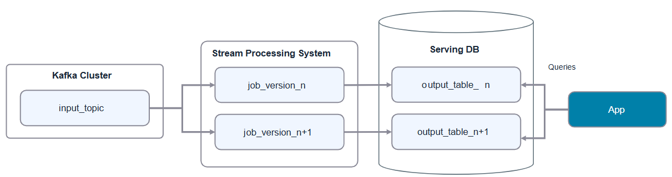
Kappa Architecture — One Streaming Path and Replay
Kappa uses one stream-processing path for live events and historical replay; it is an alternative to Lambda, not its superset.
  A durable, replayable event log—often Kafka, but not necessarily—retains the input history
  The same processing logic handles live events and replayed events
  Derived outputs can be rebuilt by starting a new processing version from an earlier position
Benefit: one processing model instead of separate batch and speed implementations.
Cost: long retention, large replay capacity, output versioning, and safe side-effect handling are required.

Slide 21
Reprocessing — Run Processing Again for Existing Input
Reprocessing means executing processing logic again for data that was processed before,
usually to rebuild or correct derived outputs.
It is not a new universal pipeline stage; it is an operational workflow around the processing stage.
Possible implementations:
  rerun one failed batch or a historical date range
  rebuild a table from retained raw data
  replay events from a durable log through the stream processor
Replay is one way to supply old input for reprocessing; the two terms are not synonyms.
Safe reprocessing needs retained input, versioned rules, deterministic logic, sufficient capacity, and isolated or idempotent outputs.
Sensor example: fix timezone conversion, rebuild last week's Silver data, validate it, then replace the published version.

Slide 22
SECTION 3 OF 4
3
Explicit and Operable Processing
Principles, contracts, processing engines, orchestrators, and DAGs
A new design question—not another mandatory pipeline stage.

Slide 23
Principles That Apply Across Processing Pipelines
These principles apply regardless of ETL or ELT, batch or streaming, and the tools used:
  Modular transformations — separate parsing, validation, enrichment, and aggregation
  Explicit contracts — define accepted inputs and promised outputs
  Deterministic results — the same input and rule version should produce the same output
  Preserved evidence — keep raw input and reason-coded rejected records
  Versioned logic — record code, configuration, and schema versions
  Validation and lineage — prove what was read, changed, rejected, and written
  Idempotent effects — a retry must not create duplicate rows, files, or notifications
  These principles apply to ETL, ELT, batch, and streaming pipelines.

Slide 24
Making Processing Explicit — A Sensor Pipeline Contract
Accepted input
  schema_version=1; event_id and sensor_id are required; event_timestamp is UTC; temperature_c is numeric
Processing rules
  deduplicate by event_id; quarantine invalid identifiers or timestamps; retain unusual temperatures with a quality flag
Promised outputs
  Silver validated readings; reason-coded quarantine records; Gold daily metrics per sensor
Evidence for every run
  input/output paths, rule version, rows read, valid, duplicate, quarantined, and written
Evolution example
  an optional location_id can be accepted without changing existing v1 calculations
The contract defines what must be true; the following slides show how processing work is executed and coordinated.

Slide 25
Processing Engine and Orchestrator — Two Logical Roles
Processing engine answers how data is transformed.
  It reads data, executes parsing, joins, validation, aggregation, or stateful logic, and writes results
  Examples: pandas, Spark, Flink, a SQL engine, or dbt executed in a warehouse
Orchestrator answers what runs, when, after what, and what happens on failure.
  It manages schedules, dependencies, parameters, retries, timeouts, and operational status
  Examples: Apache Airflow, Azure Data Factory, Dagster, or Prefect
Usually the orchestrator invokes and monitors a processing engine;
the engine is not literally inside the orchestrator.
These are logical responsibilities, not mandatory separate products—
one platform may implement parts of both.
Example:
  Airflow starts a Spark job and waits for its status; Spark performs the distributed aggregation.

Slide 26
Orchestration — A DAG with Useful Failure Boundaries
Example DAG:
  check_input → extract → validate → transform → quality_check → publish
  validate → quarantine_invalid
Why separate tasks?
  each step has one clear responsibility and observable status
  a transient extract failure can retry without repeating successful downstream work
  validation can isolate bad records before business calculations
  quality_check prevents incomplete output from being published
Store datasets in durable storage; pass paths, run IDs, and small metadata between tasks.
(This graph previews the Lab 05 Airflow workflow.)

Slide 27
SECTION 4 OF 4
4
Reliable Processing
Data quality, scalability, service constraints, retries, quarantine, idempotency, and observability
A new design question—not another mandatory pipeline stage.

Slide 28
Reliable Processing — Overview and Failure Responses
The following slides expand seven reliability questions:
  Invalid input → should we reject, quarantine, flag, or continue?
  Too much or uneven work → how do parallelism, partitioning, and skew affect us?
  Freshness and service constraints → what latency, completeness, throughput, and cost are acceptable?
  Transient system failure → when and how should we retry?
  Unprocessable records → how are they quarantined and later reprocessed?
  Repeated execution → will retries and reruns remain idempotent?
  Unknown outcome → what evidence proves that processing worked?
Quick failure rule:
  retry transient failures; fail fast on permanent faults; handle bad data according to an explicit quality policy.

Slide 29
Reliable Processing — Data Quality Decisions
Dataset-level contract failure:
  Example: the required event_id column is missing from the entire input
  Typical response: reject the run because normal processing is unsafe
Record-level quality failure:
  Example: 18 of 1,000 rows contain malformed timestamps
  Possible response: process 982 valid rows and quarantine 18 with reason codes
Business-significant anomaly:
  Example: temperature_c=85 may be real → preserve it and attach a quality flag
Never silently discard evidence. Publish counts and define who owns quarantined data.

Slide 30
Reliable Processing — Scalability and Skew
Horizontal scaling helps only when work can be divided and executed in parallel.
Partitioning determines where records and state are processed.
  Example: partition by sensor_id so readings for one sensor reach the same stateful worker
Too few partitions limit parallelism; too many create scheduling and metadata overhead.
Skew occurs when one key receives much more data than others.
  Example: one faulty sensor emits 50% of all events and overloads one partition
Joins and group-bys may require expensive data shuffles across workers.
Measure the slowest stage, partition distribution, processing rate, and lag before adding resources.

Slide 31
Reliable Processing — Latency, Throughput, Completeness & Cost
Latency — how long until a result becomes usable?
Throughput — how much data can be processed per unit time?
Completeness — how much late or temporarily unavailable data is included?
Cost — what compute, storage, and operational effort does the design require?
Batching amortizes startup and I/O overhead, often improving throughput and cost.
Streaming reduces waiting time but operates continuously and may maintain state.
Sensor example:
  daily report → wait for a complete partition and optimize for cost
  five-minute alert → accept an explicit late-data policy and higher operational complexity
Choose the least complex design that meets the actual freshness requirement.

Slide 32
Reliable Processing — Retry Policy
Retry when the same operation may succeed without changing code or configuration.
  Examples: timeout, temporary service unavailability, or rate limiting
A safe retry policy includes:
  maximum attempts and maximum total duration
  exponential backoff with jitter to avoid synchronized retry storms
  an alert or escalation after retries are exhausted
Fail fast for invalid credentials, incompatible schemas, and deterministic code errors.
Every retried task must be idempotent or protect its side effects.
Airflow example:
  retry a temporary Blob Storage timeout three times; do not retry a missing required column.

Slide 33
Reliable Processing — Quarantine and Dead-letter Paths
A quarantine or dead-letter path stores records that normal processing cannot safely accept.
Store enough evidence for diagnosis and reprocessing:
  original payload, failure reason, rule version, source, event time, and processing run ID
It does not guarantee that no data is lost.
  The path needs monitoring, retention, access control, ownership, and a reprocessing procedure
Streaming platforms commonly implement this as a separate topic, container, or table owned by the consumer.
Sensor example:
  malformed timestamps go to quarantine; after correction they are replayed through validation.
A growing quarantine is an incident signal, not successful error handling.

Slide 34
Reliable Processing — Idempotency
Idempotency: Processing the same logical input again produces the same observable outcome.
Useful techniques:
  identify records with a stable key such as event_id
  write to a deterministic run/date partition or use a transactional merge
  publish an output only after validation succeeds
  avoid duplicate notifications, counters, and other external side effects
Sensor example:
  rerunning proc_date=2026-09-10 replaces or merges the same Silver partition and does not double the daily count.
An upsert helps, but non-deterministic timestamps or side effects can still break idempotency.

Slide 35
Reliable Processing — Observability
Run and task health — status, duration, retries, resource use
Data volume — records read, valid, duplicate, quarantined, and written
Data quality — null, range, uniqueness, and schema-contract failures
Freshness — latest source event time and time until usable output
Lineage — input paths and versions that produced each output
Example run report:
  run_id=2026-09-10 | 1,000 read | 979 valid | 3 duplicate | 18 quarantined | 979 written
  latest_event_time=10:55 | published_at=11:03 | freshness_delay=8 minutes
Logs explain individual failures; metrics reveal trends and missing work.
The goal is to prove what arrived, what changed, what failed, and what is missing.

Slide 36
From Processed Data to a Data Product
A processed dataset becomes a reusable product when consumers can understand and rely on it.
Required qualities:
  clear purpose, owner, schema, semantics, and access policy
  documented quality and freshness expectations
  discoverable metadata and lineage
  stable delivery through tables, files, APIs, or feature stores
Sensor examples:
  Silver validated readings for analysts and downstream processing
  Gold daily sensor metrics for dashboards and operational reporting
Processing creates trustworthy outputs; product thinking makes them usable and accountable.

Slide 37
Lab 05 Preview — A Reliable Batch Processing DAG
Input: Bronze sensor data from Azure Blob Storage
Airflow DAG:
  check_input → extract → validate → transform → quality_check → publish
  validate → quarantine_invalid
Processing implementation: testable Python/pandas functions outside the DAG definition
Outputs:
  Silver validated readings, reason-coded quarantine records, and a quality report
Reliability exercise:
  observe a deliberate transient failure, retry it, then rerun safely without duplicate output
Airflow coordinates and exposes task status; the Python processing code transforms the data.

Slide 38
Appendix — Information Extraction
Information extraction derives explicit structure from unstructured or semi-structured content.
Examples:
  Text — identify people, organizations, locations, or topics
  Logs — parse timestamp, level, user, file, and message
  Documents — extract title, author, language, and embedded metadata
  Images — read capture time, geotag, dimensions, or device metadata
Possible tools: regular expressions and Grok patterns, Apache Tika, spaCy, or custom code.
The output should have a documented schema that later filters, joins, and aggregations can use.
Extraction adds structure; validation decides whether the extracted values are acceptable.

Slide 39
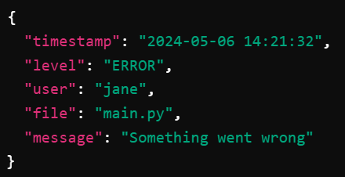
Appendix — Information Extraction Log Example
Example: turn one semi-structured application log into typed fields
1. Raw log line
2. Grok pattern names the fields to capture
3. Structured record
Once parsed, errors can be counted by user, file, time window, or error message.

